Slide 1
MUMBAI -The Commercial City to Excel the Opportunity
Coursera IBM DS Capstone Project
~ RajESWARI B

Slide 2
Introduction:
Mumbai is the commercial capital of India.
Mumbai developed a highly diversified infrastructure.
With its diverse society, comes diverse infrastructure which
decides the quality of living.
When one moves to a new city like Mumbai, is where to find a
good area to build and grow prosperously.
The purpose is to help people in exploring better facilities around their neighbourhood

Slide 3
Business Problem :
List and visualize all major parts of Mumbai City with top existing infrastructure.
What are the best locations in Mumbai as per infrastructure?
Which areas have the potential for the development of infrastructure of different kinds?
Which all areas lack the infrastructure facilities?
What is the best place to stay within a city for all vital infrastructure facilities?

Slide 4
Data acquisition and cleaning:
For this project we need the following data:
Mumbai Pencoed (Scraped from web source)
Mumbai City data (Geospace Data on Mumbai Pencoed)
Different infrastructures in each neighbourhood of Mumbai City data (Foursquare API)

Slide 5
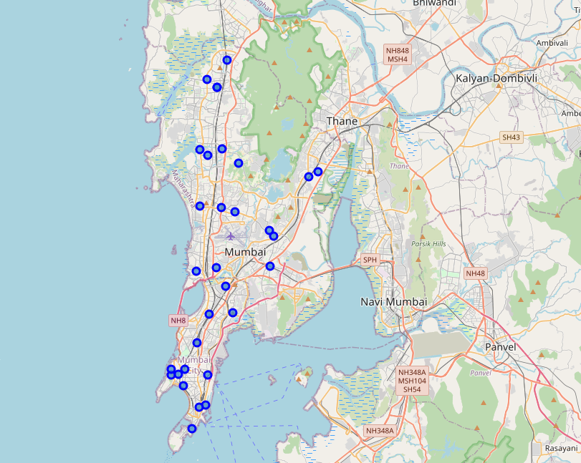
Results:
Top Existing Infrastructure

Slide 6
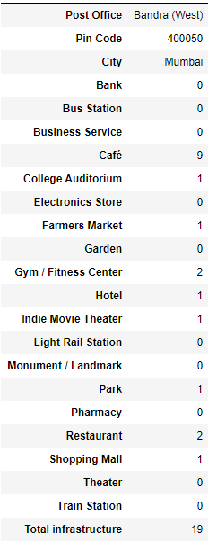
Results:
Best Location as per infrastructure

Slide 7
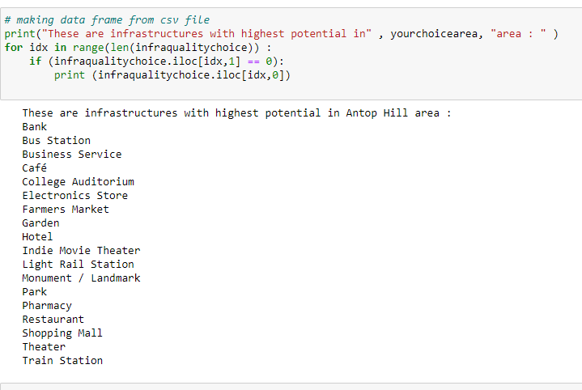
Results:
Highest Potential Antop Hill:

Slide 8
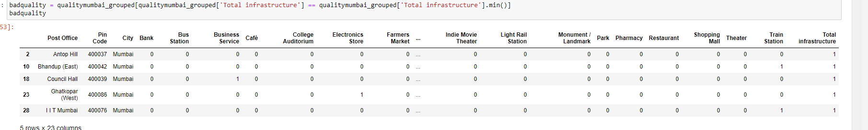
Results:
Lack of Infra Facilities:

Slide 9
Conclusion and future work
In this project, I have gone through the process of identifying the business problems, specifying the data required, extracting and preparing the data, visualizing the results, performing machine learning by clustering the data into 3 clusters based on their frequency similarities, tackling and reaching to a definitive solution to business problems (mentioned in results).
Lastly, the project is providing recommendations to the relevant stakeholders i.e., business developers regarding the best locations to open a new infrastructure. The project also provides visitors and immigrants to the city regarding postal office areas for growth and living prosperously

